Slide 1
BATTLE OF BRITAN
By Jam Education

Slide 2
An Introduction
Great Britain's air force was called the RAF or the Royal Air Force. Germany's air force was called the Luftwaffe. The code name for Hitler's invasion plans was Operation Sea Lion. It is estimated that around 1,000 British planes were shot down during the battle, while over 1,800 German planes were destroyed.

Slide 3
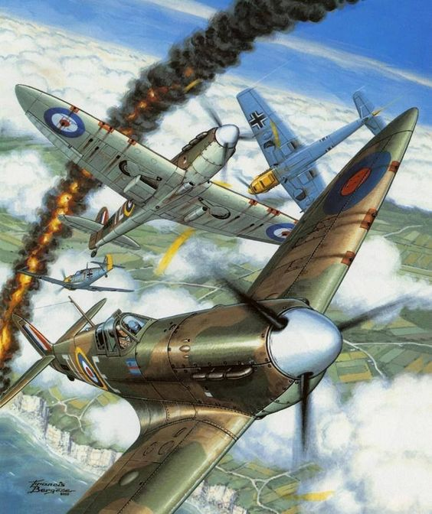
planes
The planes names are Lancaster bomber, the Junkers, the Spitfire and last but not least the Messerschmitt.

Slide 4

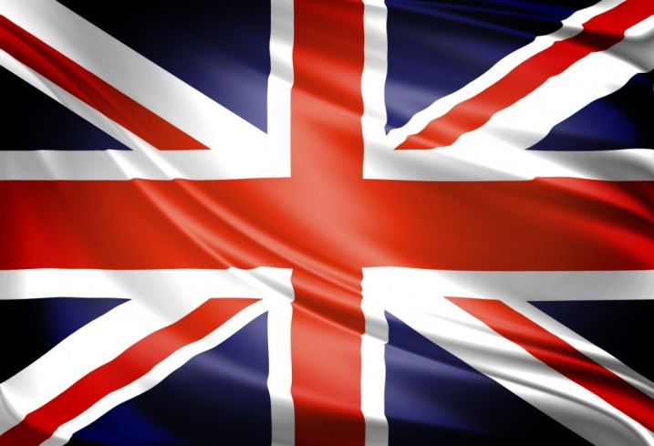
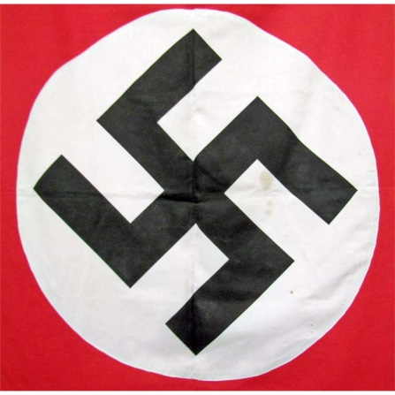
teams
VS
Luftwaffe RAF(royal air force)
Hitler Winston Churchill

Slide 5
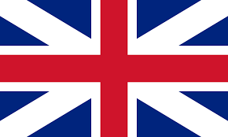
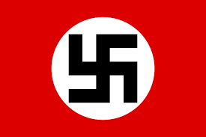
Teams Main Planes
RAF
Spitfire
Lancaster
Luftwaffe
Messerschmitt
Junkers

Slide 6
Soldiers
There weren't any soldiers in the battle of Britain. Although there were some soldiers on the ground fighting in WW2 (World War 2).

Slide 7
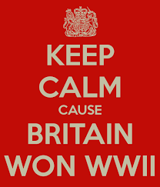
In The End
In the end the British planes won because the German Luftwaffe was destroyed.

Slide 8
The end
Thanks For Watching.
Please Visit:
Jam Education History

