Slide 1
Castles
Why and how did castles change after 1066?
By Jam education
Jameducation3.yolasite.com

Slide 2
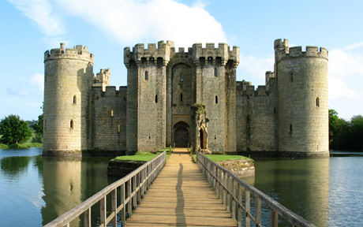
What Were they For?
The castles were required so that the Normans could remain safe and in control. Major castles were built-in or near large centres of population. The aristocrats would shelter here when an attack was present. They were originally built to provide safety and protection from attack and later on to display the owner's rank and wealth.
What are They?
A castle is a large strong building, built in the past by the peasants commanded by a lord or important person to protect the people inside from attack. They were both a home and a fortress.

Slide 3
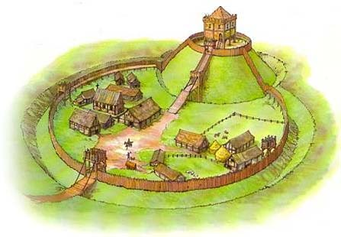
Motte and bailey.
Types
There were different types of castles. As more advanced attack methods came in there had to be more defensive castles made.
​Motte and Bailey castles were the early type of castle and had 2 levels and were very basic. The Bailey was where the farm was and the workers. That was at the bottom of the hill. On the motte the castle stands. The motte overlooks the bailey. It was a good setup because any attackers would have to get up the steep hill.

Slide 4
Strengths
Motte and Bailey Castles
weaknesses
It often has a moat to keep intruders out.
To let people over the moat there was a bridge but to stop attackers crossing that bridge there was a drawbridge that could be hoisted up if necessary.
It was a lot quicker than stone castles to build.
The wood was very easy to find because most of England was just forests.
It was made of wood so it could be burned down.
It would rot over time whereas stone castles would stay for longer.
New weapons were brought in that easily destroyed the wooden castle.

Slide 5
Stone
The following stones were used to build stone castles.
Flint
Hard Chalk
Limestone
Sandstone
Stone castles were like motte and bailey castles apart from the walls were higher and made of stone. It didn’t really have a bailey it just had the castle usually on top of a hill with a moat and a drawbridge.

Slide 6
Strengths
Stone Castles
Weaknesses
It was protective against fire.
Would not rot so it would last longer.
The walls were a lot stronger against attack than wooden castles.
Flaming arrows could be used to destroy the inside of the castle which was usually made of wood for the floor and furniture.
Eventually when the cannon came it became possible to breach the castle walls.
It took a very long time to build so attack could come before it was built.
A lot of stone was needed to build it. But you had to quarry and mine to get the stone with lots of men.

Slide 7
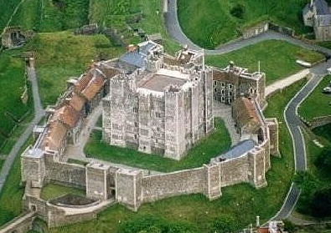
Concentric Castles
Concentric Castles can be described as "a Castle within a Castle". They had two or three walls around the keep. The inside walls were built higher than the outside walls. This meant that defenders could fire arrows over the heads of the soldiers defending the outside walls.

Slide 8
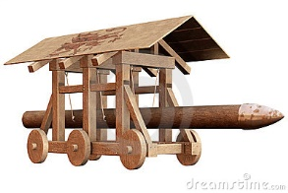
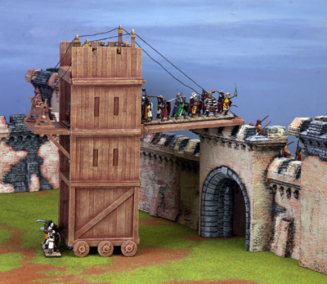
Attack Methods
Battering Ram
A battering Ram is a siege engine that originated in ancient times and is designed to break open the walls of a fortification or splinter the wooden gates.
Siege Tower
Siege towers were used by troops over an enemy wall. When a siege tower was near a wall it would drop a gangplank between it and the wall. Troops could then rush onto the walls then into the castle.

Slide 9
Attack Methods
Mangonel
The mangonel works by pulling a long arm with a bucket attached down to form its 90o angle of equilibrium. By doing this the potential energy of the catapult is in the ropes and the arm ready to fire a rock.
Trebuchet
It is a similar weapon to the mangonel but it has a more powerful aim and fire. It was used to fire flaming bombs over the castle walls and into the castle to attack.
Best?
Personally the Trebuchet is the best because you can ensure that it is powerful enough to go over the walls.
Notes:
Nearly end!!!

Slide 10
Defending Them
They would shoot arrows out of arrow slits in the castle walls. Buckets of hot oil would also be thrown down near the entrance to stop intruders.

Slide 11
Conclusion
The main reason castles changed after 1066 was because they had to respond to new methods of attack.
The best type are probably a concentric castle as they are the highest in defence and attack. There are lots of different tools used to attack a castle but the best is the trebuchet because it fires accurate balls of flaming cloth or rocks over the castle walls and damages the inside. To defend a castle the best method of stopping and defeating the enemy is by shooting arrows but when the enemy gets to the castle walls the hot oil would easily stop them.

Slide 12
Thanks
I thank the following sources for their information.
Google ICloud Notes
Wikipedia themcs.com
Hollyhallacadamy ©Susaeta Ediciones
© The british library board © interfoto
© Wallice Collection ©The trusties of the©British Museum
©Hemis ©The Print Collector
©Skyscan Photolibrary ©The Victoria Albert Museum
©Tiber Bognar/Corbis ©The Art Archive
The two sources that I found the best are Google and Wikipedia

Slide 13
Thank You For Watching
Made by Jam Education
Jameducation3.yolasite.com

