Slide 1
Ancient Egypt Daily life
Made By
Jam Education

Slide 2
Houses
The people of ancient Egypt built mudbrick homes in villages and in the country.

Slide 3
Food
They grew some of their own food and traded in the villages for the food and goods they could not produce. They had lovely food at festivals.

Slide 4
Work
Most people worked as either a field hand, farmer, craftsmen or scribe.

Slide 5
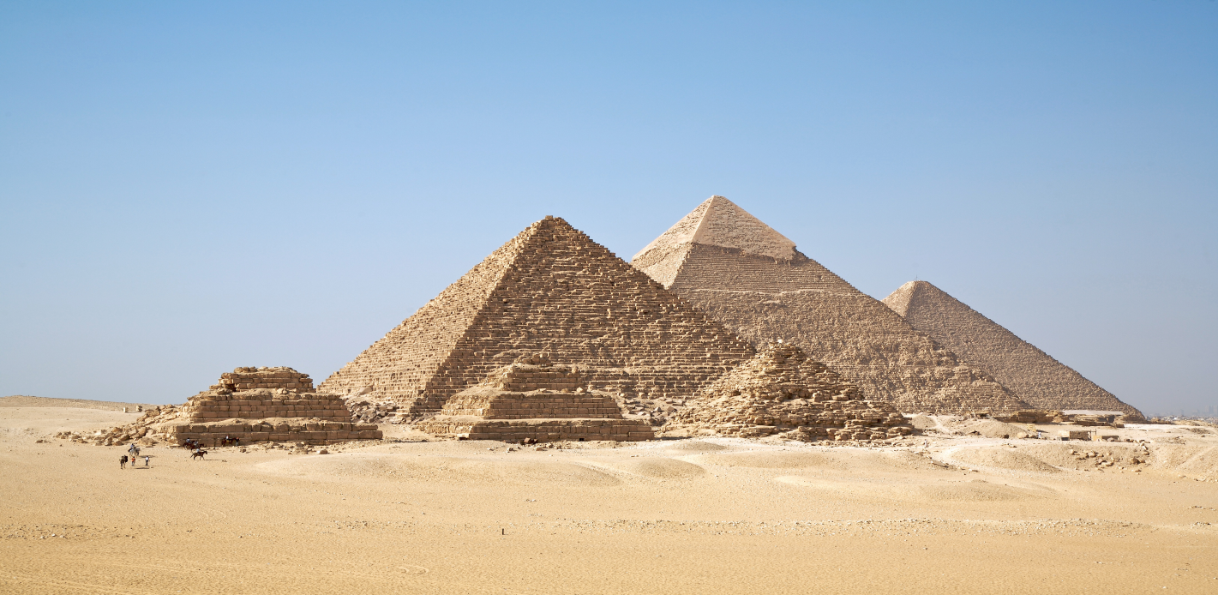
Thank You
Thank You for watching. More education PowerPoints can be found at Jam Education.

