Slide 1
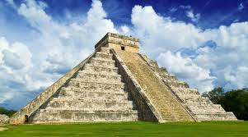
Mayans
By Jam Education

Slide 2
Food
Papadzules
Squash
Beans
Maize
Chilli Peppers
Meat
Seafood
The main food that Mayans eat was maize. It is a vegetable and fairly easy to find.

Slide 3
Writing
The Mayans communicated using hieroglyphics. They would make ink and put it on scrolls or engrave it in stone.

Slide 4
Drinking
The Mayans mainly drank water from streams. If you could make it or afford it you could chocolate.

